Slide 1
Cucumber framework with capybara
kirubanand

Slide 2
How to download ruby gems
Go to https://rubygems.org/pages/download
Download ruby gems gem file.
And install in cmd gem install rubygems-update-2.4.3.gem.
And execute gem install selenium.
And execute gem install capybara.
And execute gem install rspec.
And execute gem install cucumber.

Slide 3
And execute gem install selenium-webdriver.
And execute gem install cucumber-webdriver.
And execute gem install active support
And execute gem install selenium-client.
And execute gem install spreed sheet.
If you want to View the list of installed gems:
gem query –local.
We need to configure ruby development kit also refer this site (without this dev kit we cant able to install gem install cucumber). https://github.com/OneClick/RubyInstaller/wiki/Development-Kit..
Download dev kit from this url http://rubyinstaller.org/downloads/

Slide 4
Refer http://rubyinstaller.org/downloads/ to download ruby.
Download ruby 1.93 installer
Gem install bundler

Slide 5
Capybara
Capybara is a library written in the Ruby programming language which makes it easy to simulate how a user interacts with your application. Capybara can talk with many different drivers which execute your tests through the same clean and simple interface. You can seamlessly choose between Selenium, Webkit or pure Ruby drivers.

Slide 6
How to generate config file
Download ruby development kit.
And extract.
Open cmd window.
Step 2: Run Installation Scripts cd <DEVKIT_INSTALL_DIR>
ruby dk.rb init to generate the config.yml file to be used later in this Step. Your installed Rubies will be listed there (only those installed by a Ruby Installer package are detected at present) edit the generated config.yml file to include installed Rubies not automatically discovered or remove Rubies you do not want to use the DevKit with.

Slide 7
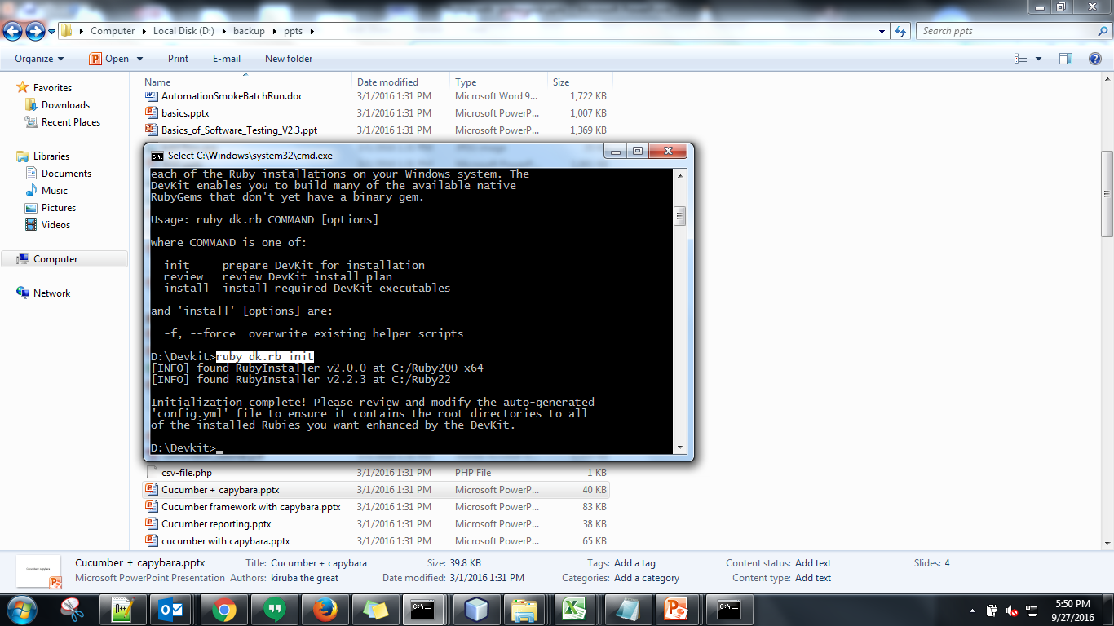

Slide 8
Download ie server
http://selenium-release.storage.googleapis.com/index.html.
To download ruby installer
http://rubyinstaller.org/downloads/

Slide 9
An example of Cucumber - Ruby - Capybara
i just want to give you an example of Cucumber test with Selenium Ruby using Capybara (a library written in Ruby which makes it easy to simulate how a user interacts with your application).
Install Ruby, ruby devkit and some rubygem for your test, such as: selenium-client, selenium-webdriver, rspec, capybara, cucumber.
Using JetBrain RubyMine editor to write test script. User can use evaluation version of RubyMine for 30 days.
Open RubyMine, go to menu File > Settings > Ruby SDK and Gems, click (+) button on the right hand side to browse to ruby.exe (the location you had installed Ruby), press OK to complete the setting.

Slide 10
cucumber basics
Cucumber test with Selenium Ruby using Capybara.
To select a select box -----find(:select, from, options).find(:option, value, options).select_option ----find("option[value='Mr.']").select_option--find("option[value='Mr.']").click
to generate results through json txt file ----cucumber features\first.feature --dry -run -f pretty -f json -o D:\ruby\selenium_ruby_using_capybara_for_rml\features\reports\reports.txt.
To generate report through html -----cucumber features\first.feature --dry-run --format html --out .\report.hmtl.
Help option cucumber -h

Slide 11
Cucumber test with Selenium Ruby using Capybara.
To select a select box -----find(:select, from, options).find(:option, value, options).select_option ----find("option[value='Mr.']").select_option--find("option[value='Mr.']").click
to generate results through json txt file ----cucumber features\first.feature --dry -run -f pretty -f json -o D:\ruby\selenium_ruby_using_capybara_for_rml\features\reports\reports.txt.
To generate report through html -----cucumber features\first.feature --dry-run --format html --out .\report.hmtl
Help option cucumber -h

